Slide 1

Recursive language models
NAVITA SINGH

Slide 2
Motivation: context rot
1. Introduction
Context rot, also called context drift or fragmentation, refers to the degradation of a Large Language Model's (LLM) performance as a conversation grows longer.
Key factors contributing to this include:
Attention Dilution: As context length increases, the model’s attention is distributed across thousands of tokens. As a result, critical instructions provided early in the prompt may gradually lose salience as additional information accumulates.
“Lost in the Middle” Effect: Empirical research indicates that large language models exhibit strong recall for information presented at the beginning and the end of a prompt, while information embedded deep within lengthy contexts is more likely to be overlooked or underutilized.
Hallucination Cascades: When a model introduces an initial error that persists in the conversational history, subsequent responses may implicitly treat that error as factual. Over time, this can lead to compounding errors and progressive degradation of reasoning quality.

Slide 3
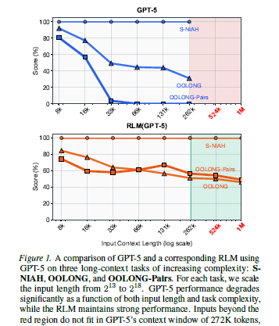
What is a Recursive Language Model?
1. Introduction
Log(2) scale: 2¹³ is ~8k, 2¹⁸ is 262k.
A Recursive Language Model is an inference-time framework. It allows a model to recursively call smaller, relevant subsets of data.
The full context is stored externally, and the model decides what parts to inspect through generated code.
This enables deliberate decomposition of complex tasks into simpler subproblems.

Slide 4
Why Recursion Matters
1. Introduction
RLMs operate by placing the full input into a persistent environment such as a Python REPL. The model writes code to search, filter, and segment the context before invoking recursive sub calls. Partial outputs are aggregated to form a coherent final answer.
Recursion enables models to reason hierarchically instead of processing everything at once. This approach improves efficiency by focusing computation only where it is needed.
As a result, RLMs scale to inputs far beyond traditional context limits.

Slide 5
OOLONG: Evaluating Long-Context Reasoning
2. Evaluation datasets
Purpose: OOLONG benchmarks the ability of large language models (LLMs) to reason over very long contexts, often spanning tens or hundreds of thousands of tokens. It tests how models retain, retrieve, and reason on information distributed throughout the input.
Task Design: Tasks are structured to place critical information at the beginning, middle, and end of prompts. This exposes how well models maintain coherence and recall across varying token positions.
Impact: By stress-testing long-context capabilities, OOLONG informs both model architecture choices and training strategies for real-world applications.

Slide 6
OOLONG
2. Evaluation datasets
Dataset Variants:
OOLONG provides both real-world (oolong-real) and synthetic (oolong-synth) datasets to evaluate LLM performance across long-context tasks. Each dataset contains structured columns enabling precise tracking of context, tasks, and outputs.
Core Columns in oolong-real:
context_window_text: Text corresponding to the episode, often a long transcript requiring multi-step reasoning.
question and answer: Question about the transcript and the correct answer for evaluation.
question_type: Categorizes task types (e.g., singledoc_rolls) to distinguish reasoning requirements.
episodes / campaign: Metadata for organizing related episodes into groups or campaigns.
Core Columns in oolong-synth:
context_len: Number of tokens in the context window, indicating context size for scaling analysis.
dataset: Indicates synthetic domain (e.g., spam).
context_window_text / context_window_text_with_labels: Original text and text with embedded labels for task evaluation.
question / task_group / task: Question to answer, task categorization (counting, retrieval, user tracking), and specific task type.

Slide 7
QWEN fine-tuning
3. Fine-tuning for RLM (Qwen models)
Objective: Fine‑tune Qwen3‑8B so it behaves effectively as a recursive language model (RLM), meaning it can write code to navigate and recurse over long inputs within a Python REPL environment
Training Data:
Started with trajectories from a much larger model (Qwen3‑Coder‑480B‑A35B) acting as an RLM on tasks from the LongBenchPro benchmark.
Collected many candidate runs, then filtered these to ~1,000 high‑quality examples . Only trajectories where the model made meaningful recursive calls were selected.
Key Insights:
Being a good sub‑call model (i.e., one that can handle recursive calls and manipulate the REPL) is similar to being a general reasoning model.
Hence, fine‑tuning is focused on improving the root model’s ability to generate valid RLM code and recursive sub‑calls.

Slide 8
QWEN fine-tuning
3. Fine-tuning for RLM (Qwen models)
Filtering & Preprocessing:: Original RLM trajectories had various mistakes (e.g., incorrect FINAL(answer) use or wrong variable calls). Researchers applied programmatic cleaning steps to fix template errors before fine‑tuning.
Training Setup:
Fine‑tuning used the cleaned trajectory dataset as supervised examples.
Each example pairs an RLM history (input + REPL state) with the correct code the RLM should emit at that step.
A simple training schedule (~300 steps, modest batch size) was enough to yield large gains at this scale (with ~48 hours on high‑end GPUs like H100).
Outcome:
The fine‑tuned model (RLM‑Qwen3‑8B) significantly improves performance on long‑context tasks compared to vanilla Qwen3‑8B (~+28% median).
It becomes much better at inspecting the REPL, making sub‑queries, and assembling recursive reasoning patterns — without being trained on huge extra corpora.

Slide 9
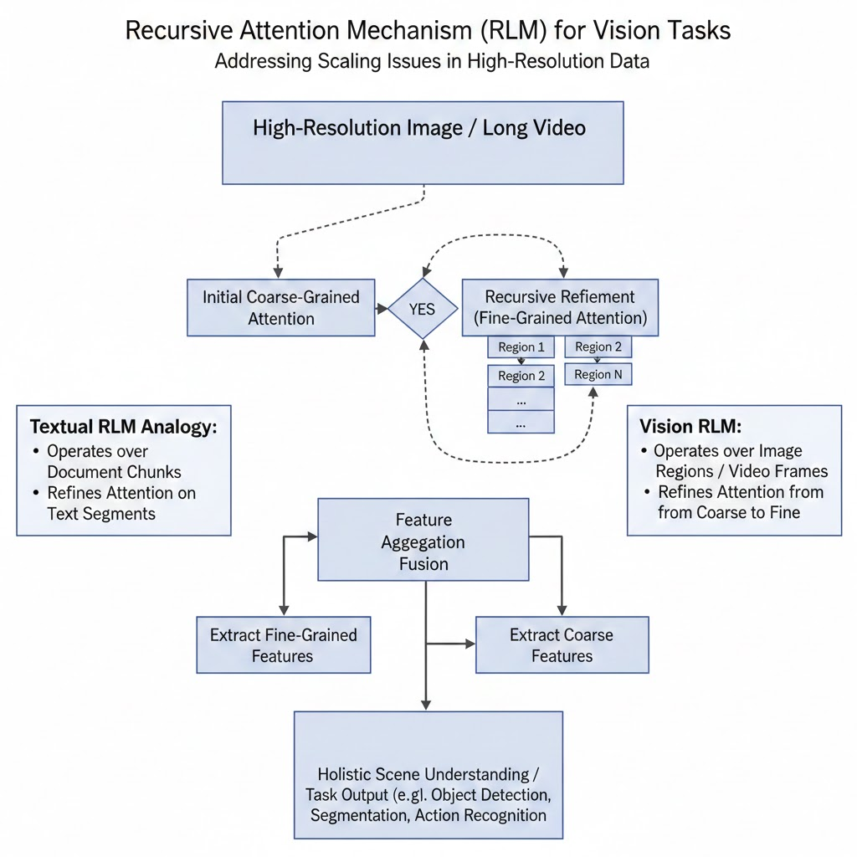
Applying RLMs to Vision Models
4. Vision models

Slide 10
Implications & Future Work
5. Conclusion
RLMs challenge the assumption that larger context windows are the primary solution to long-context reasoning.
They suggest a future of program-guided, recursive perception across modalities.
This approach has strong implications for multimodal AI and long-horizon reasoning systems.

